Slide 1

Store Sales Forecasting
Harikrishna Dev - HXD220000
Jaswanth Reddy Yanumula - JXY210004
Abhiram Mane - AXM220137
Amit Mishra - AKM220000
Soumyajit Mishra - SXM220133
Notes:
Save this document with a new name before you begin work.
When adding a new slide, click on the small arrow next to “New Slide” on the toolbar. Select the layout that will best fit the content you want to add.
Change the layout of an existing slide: click the “Layout” button on the top toolbar to reformat your existing content to another master slide.
Refer to utdallas.edu/brand for specific rules on using the University logos and wordmarks.

Slide 2


Store sales in Ecuador
Problem statement
Favorita Corporation is Ecuador’s favorite retailer.
Its different lines of business and formats allow them to adapt its products, services, and experiences offering to the local realities, according to customers’ needs.
Ecuador is reliable in its Oil resources. Therefore, gas prices affect the economy and daily wages of the population.
Ecuador holds 8,273,000,000 barrels of proven oil reserves as of 2016, ranking 19th in the world and accounting for about 0.5% of the world's total oil reserves of 1,650,585,140,000 barrels.

Slide 3
Dataset
Our dataset is from Kaggle and is part of the Time series competitions.
We chose this dataset as it could have seasonal aspects and significantly impact holidays and the country's economic dependence on oil prices.
There are 54 stores and 33 product families in the data. The time series starts from 2013-01-01 and finishes in 2017-08-31.
We also have oil prices for the same time period.
Other key features:
Wages in the public sector are paid every two weeks on the 15th and on the last day of the month. Supermarket sales could be affected by this.

Slide 4
Data
The data contains target sales and the time series for the features store_nbr, family, and onpromotion.
The store where the goods are sold is identified by the variable store_nbr.
The family identifies the category of the sold goods.
sales provides the overall sales for a family of products at a specific retailer on a specific day. Since products can be sold in fractional units (1.5 kg of cheese, as opposed to 1 bag of chips, for example), fractional values are possible.
OnPromotion displays the total number of products from a family that were on sale at a retailer on a specific date.

Slide 5
Data
Daily oil price. (Ecuador is an oil-dependent country and its economical health is highly vulnerable to shocks in oil prices.)
Holidays and Events, with metadata
The transferred column containing holidays that are transferred officially falls on that calendar day but was moved to another date by the government
We have performed pre-processing and feature engineering to help us with our analysis.

Slide 6
Literature Review
Time series analysis is a statistical method used to analyze and interpret data points collected over a period of time. The time series data could be collected on a daily, weekly, monthly, or yearly basis. Time series analysis is widely used in economics, finance, engineering, and social sciences to forecast trends, identify patterns, and make predictions based on historical data.
We take our reference from Intelligent Demand Forecasting published by Nimai Chand Das Adhikari, Nishanth Domakonda, Chinmaya Chandan, Gaurav Gupta, Rajat Garg, S Teja, Lalit Das, Dr. Ashutosh Misra where they use SES model, Moving Average, Croston Model and Seasonal Linear Regression with Time Series and Regression based algorithms to prove that both algorithms put together bring out the result close to actual rather than under-forecasting or over-forecasting.
Also, Comparative Study between Classical Methods and Machine Learning Algorithm for TSA published by Heba Salah, Mohammed Hussein and Ismail Zahran compared Demand Forecasting scope by applying both the algorithms and concluded by giving positives and negatives for CM and MLA.

Slide 7
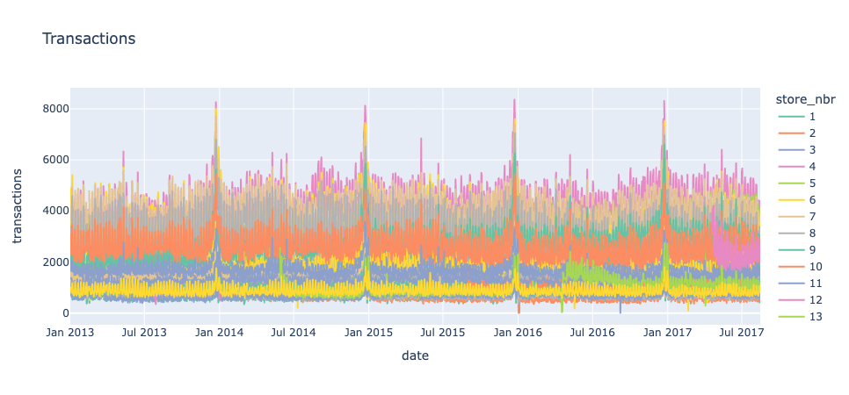
Seasonality parameter checks
Seasonality of Sales and Transactions was of utmost importance.
We can see that most trends are monthly and weekly.
Sales and transactions are highly correlated as expected.

Slide 8
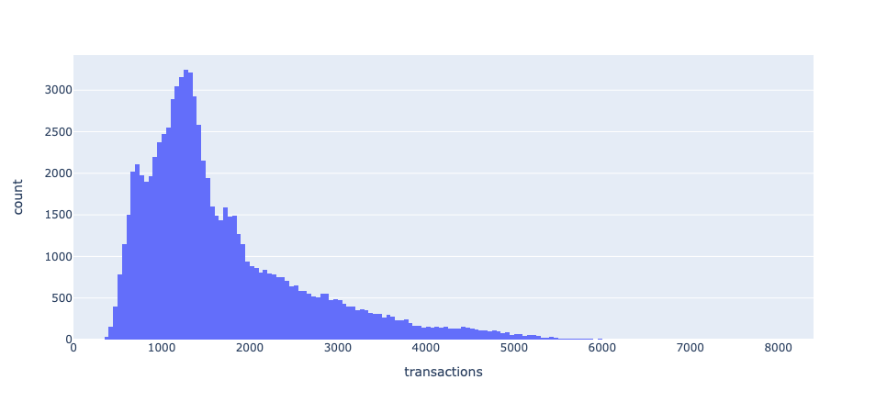
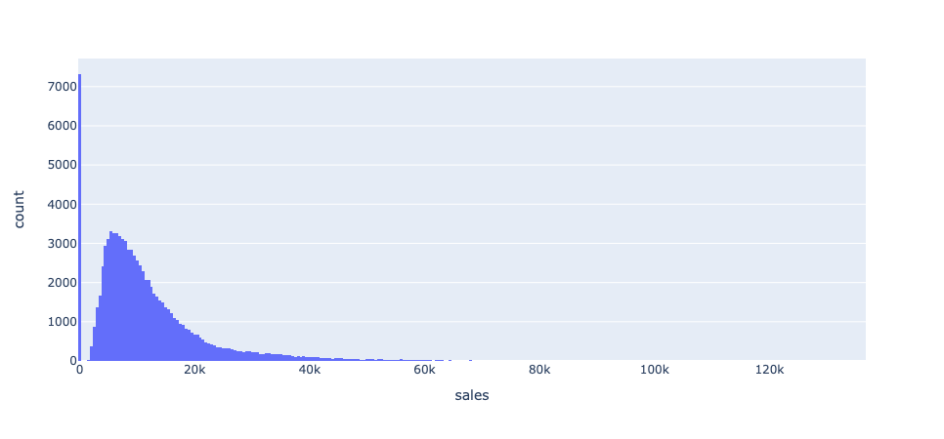
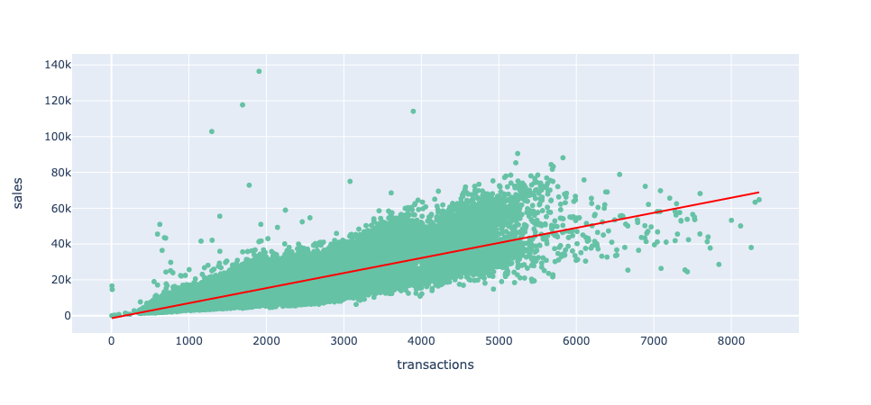
We should use Inter-Quartile scaling methods since the data is left skewed, indicating that most of the sales.
Seasonality parameter checks

Slide 9
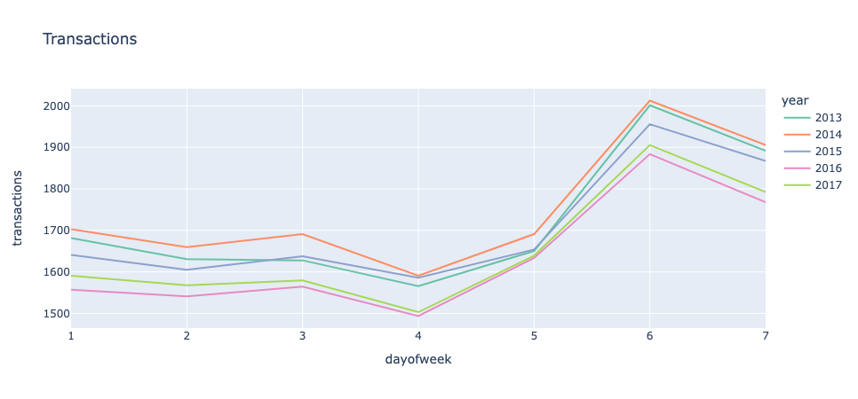
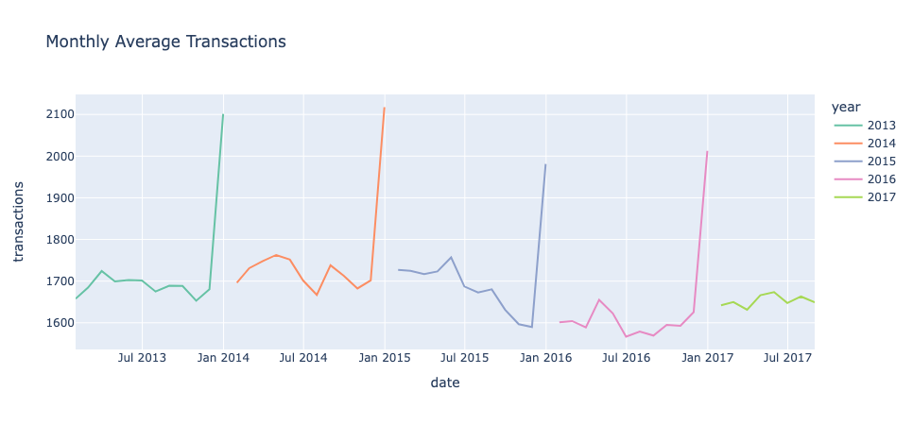
From the weekly and monthly average transactions chart we can infer that the month of December and Saturdays look to have the highest amount of transactions
Seasonality parameter checks

Slide 10
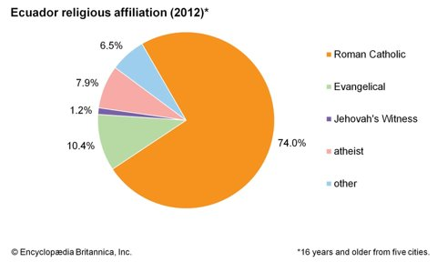
Seasonality reasoning
From the following pie-chart we can see that majority of the population identify as Roman Catholic/Christians.
This explains why we observe majority of the sales being on Saturdays and during the month of December as Christmas is the major festival for the people in Ecuador and Christians tend to visit the church on Sundays while being busy on the weekdays.

Slide 11
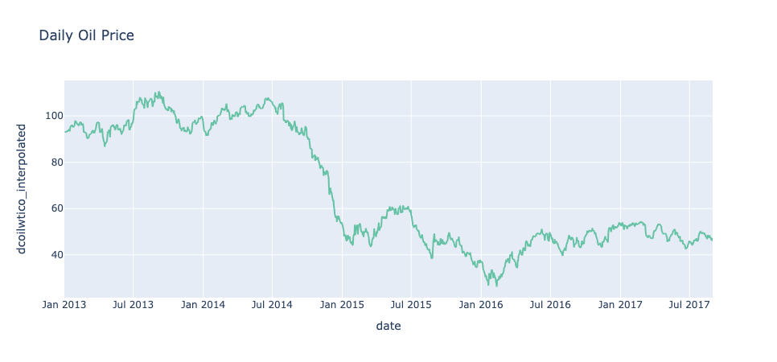
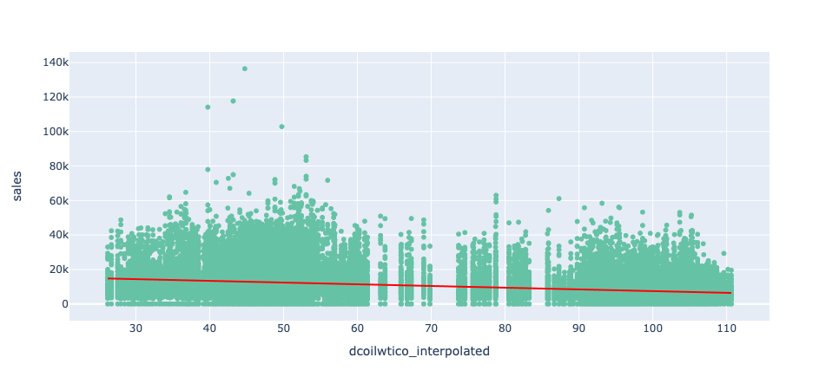
Seasonality parameter checks
The correlation between Sales and Oil prices was also a big factor.
Corr(Oil, Sales) = -0.300274
We fit the missing oil prices using interpolations using the linear transformer.

Slide 12
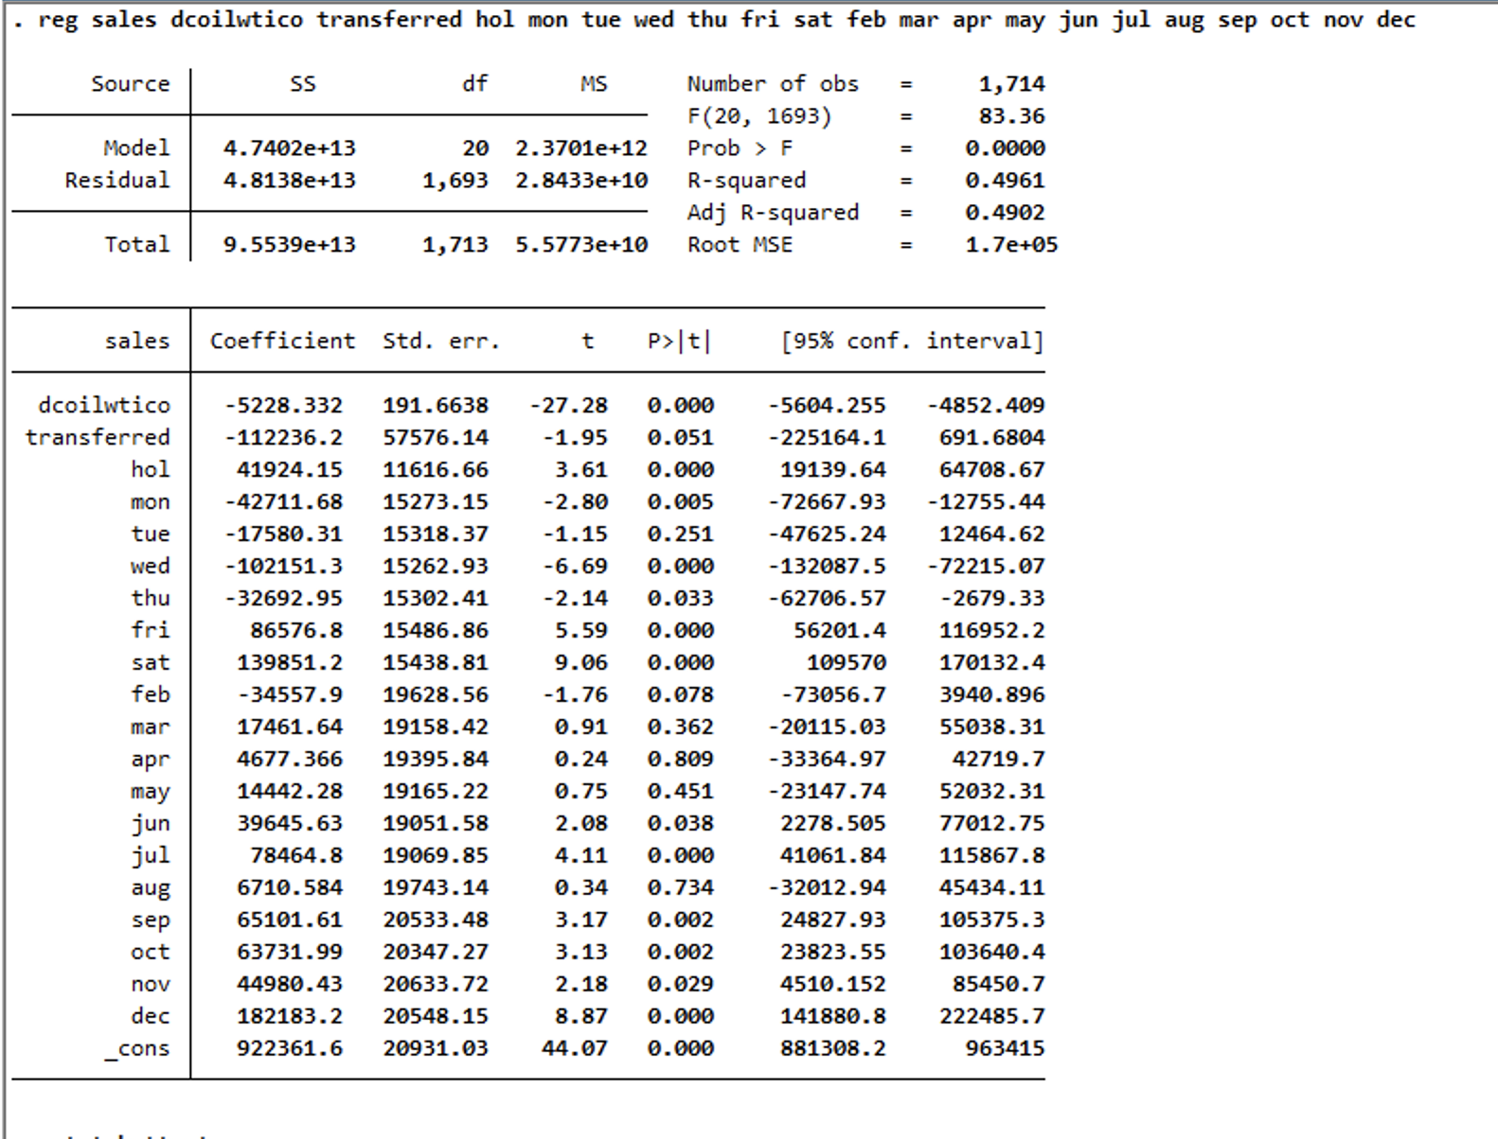
Model used: Linear Regression

Slide 13
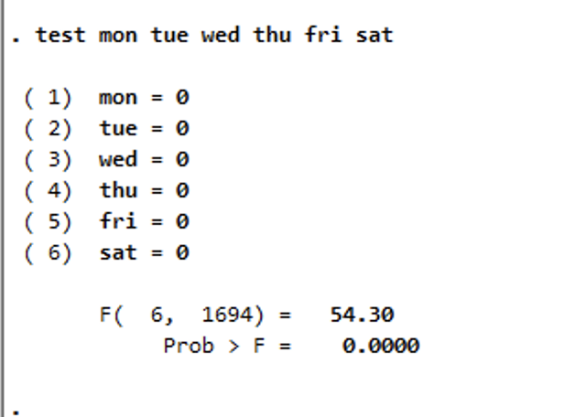
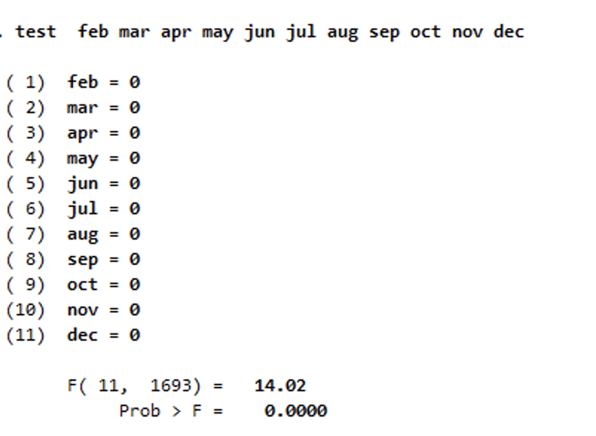
F-test to check for seasonality
The null hypothesis for both tests is that the coefficients for all the variables being tested are equal to zero, which means there is no relationship between the variables and the sales of the product. Both tests reject the null hypothesis, meaning that at least one of the coefficients being tested is not equal to zero, and there is a relationship between the variables being tested and the sales of the product.

Slide 14
Dickey fuller test
Seasonality check
$${∆sales}_{t}= a_{0}+{δsales}_{t−1}+u_{t}$$
H0: The data is stationary (Sales has no unit root)
H1: The data is not stationary (Sales has unit root)
T-statistic: -14.378180855386148
P-value: 9.248325968569156e-27
We reject the null hypothesis i.e., the sales data is not stationary.

Slide 15
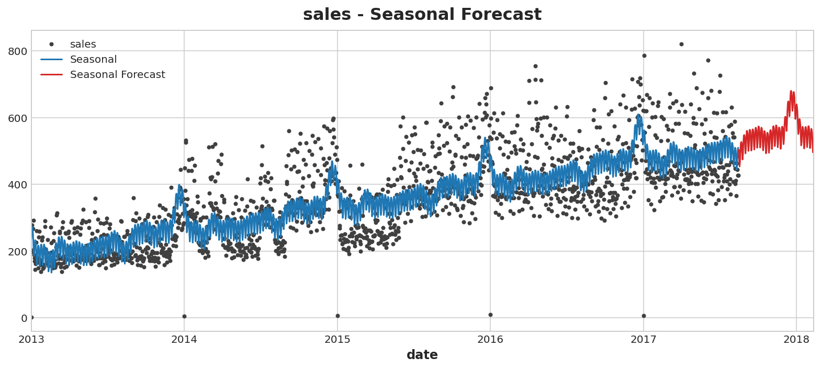
Results and Conclusion
R sqr Score: 0.4961
Even after adding different variables and different regression techniques, we are not able to decrease the heteroskedastic nature of estimates.
We received a p-value > threshold while conducting the Breusch Pagan Test on the regression equation.

Slide 16
Future improvements
Conclusion
Adding factors such as Customer experience metrics such as NPS, CSAT and
Running an Elastic Net regression than a Linear regression to decrease the issue due to different scaling in the input dataset.
Multinomial Classification models where our classes are ranges of predicted sales would be a good method of predicting the sales according to the Tsan-Ming Choi in `Sales Forecasting for Fashion Retailing Service Industry: A Review`.

